Slide 1


R Johnson Manuel
23-04-2023

Slide 2

Outline
Executive Summary
Introduction
Methodology
Results
Conclusion
Appendix

Slide 3
Executive Summary
Summary of methodologies
Summary of all results

Slide 4
Introduction
Project background and context
There is no way to predict rockets success rate.
Problems you want to find answers
Analyze the data collected by previous launches and predict the falcon 9 launches will be successful in the future.

Slide 5

Section 1

Slide 6
Methodology
Executive Summary
Data collection methodology:
We use Data collection API and Web Scraping to collect data from Spacex and websites.
Perform data wrangling
The process of cleaning the data for machine learning by removing the null values and other wrong values and converting categorical values to numeric.
Perform exploratory data analysis (EDA) using visualization and SQL
Perform interactive visual analytics using Folium and Plotly Dash
Perform predictive analysis using classification models
We use scikit-learn to train and test our models.

Slide 7
Data Collection
Describe how data sets were collected.
By using web scraping method from various websites as well as using data provided by SpaceX
You need to present your data collection process use key phrases and flowcharts
We use the Requests API in Python to Fetch the data from the websites and we use the Beautiful Soup package to process the webpage and extract the data from the content.
The Data collected has also been done by website having data related to the falcon 9s Ie: SpaceX has this data available on their research website. This is available on the IBM asset exchange as well.

Slide 8
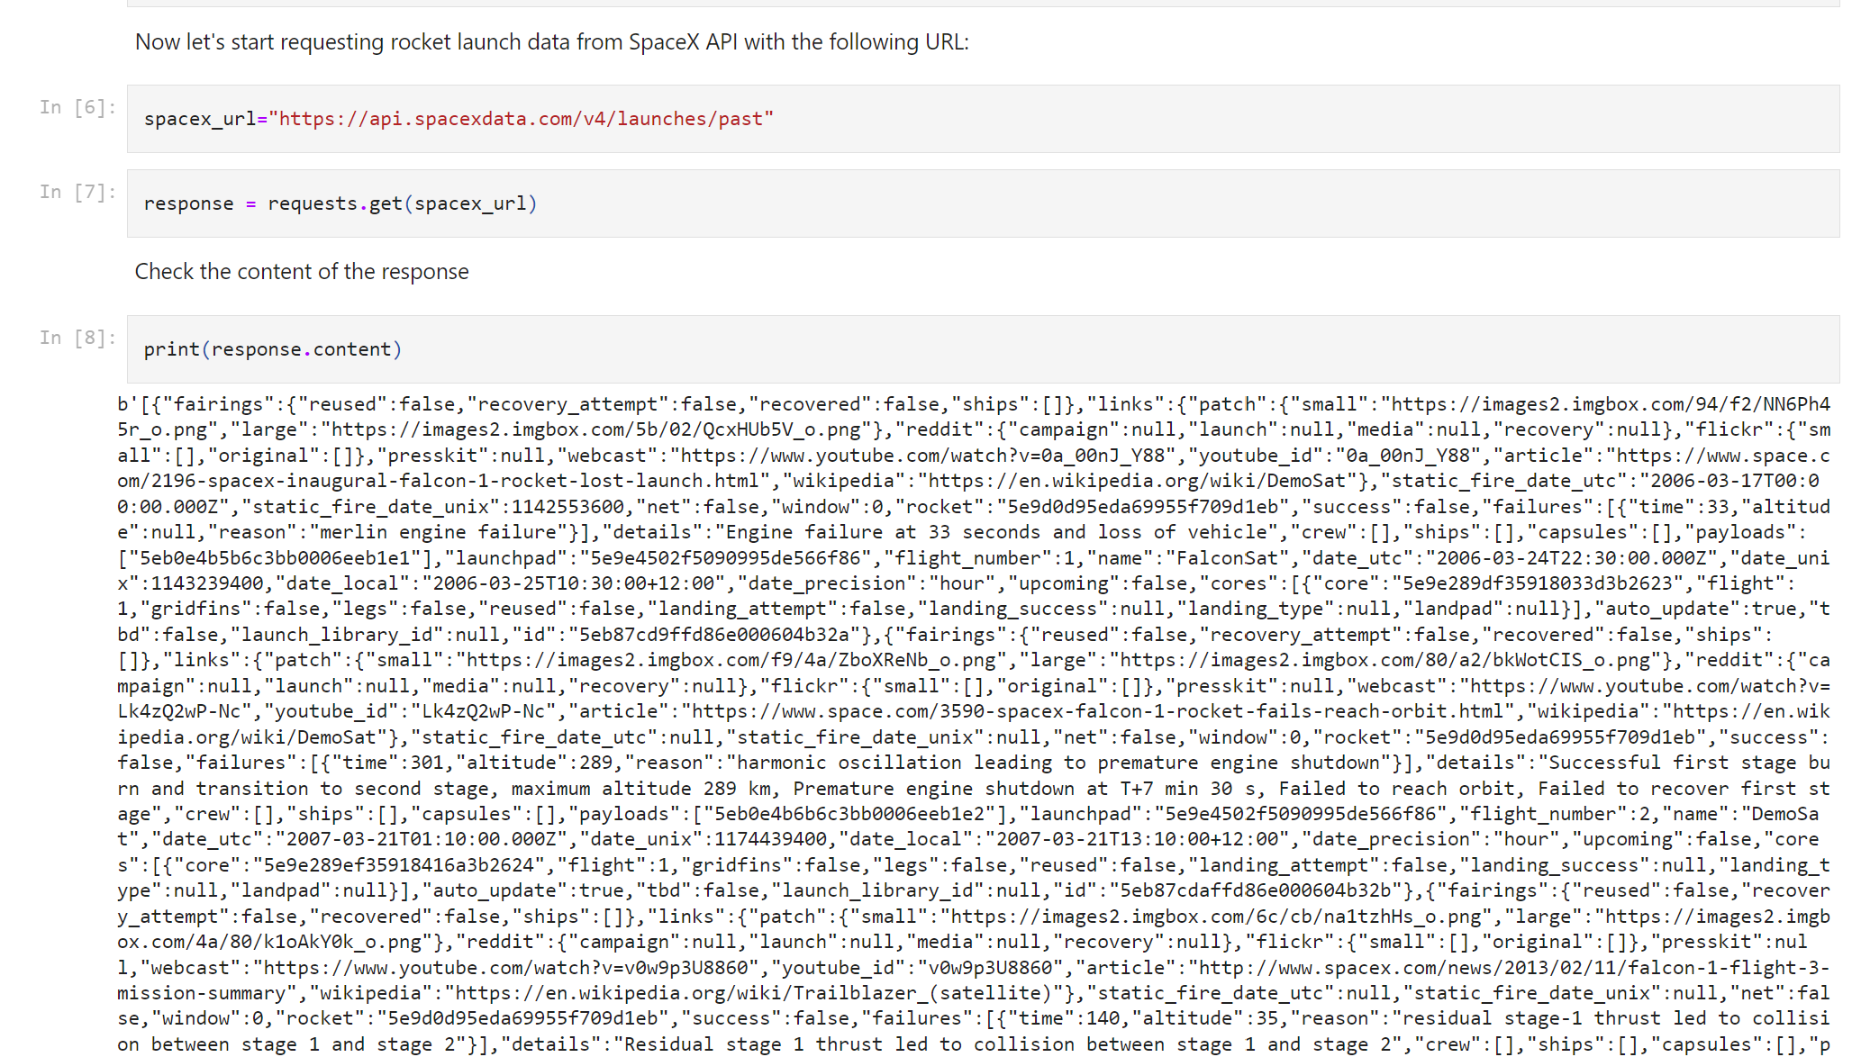
Data Collection – SpaceX API
Requests
request
Webpage
response
Notebook GIT link:
https://github.com/JohnsonManuel/Capstone-IBM/blob/master/Data%20Collection%20API%20LAB%201%20-%20IBM%20-%20Week%201.ipynb

Slide 9
Data Collection - Scraping
The webscraping is process of getting the data from webpages and converting them into pandas dataframes for wrangling and data processing
Notebook URL:
https://github.com/JohnsonManuel/Capstone-IBM/blob/master/Web%20Scraping%20LAB1%20-%20Week%201%20-%20IBM.ipynb
Requests
request
Webpage
response

Slide 10
Data Wrangling
The data was cleaned by removing Null values .
The data wrangling process removed empty values and converted Categorical values to weighted values
The process one hot coding was used and data was replaced with columns to better represent them
Wrong values were also removed and Replaced with either mean or average values in some cases.
Notebook URL :
https://github.com/JohnsonManuel/Capstone-IBM/blob/master/Data%20Wrangling%20-%20LAB%202%20%20-%20Week1%20-%20IBM.ipynb

Slide 11
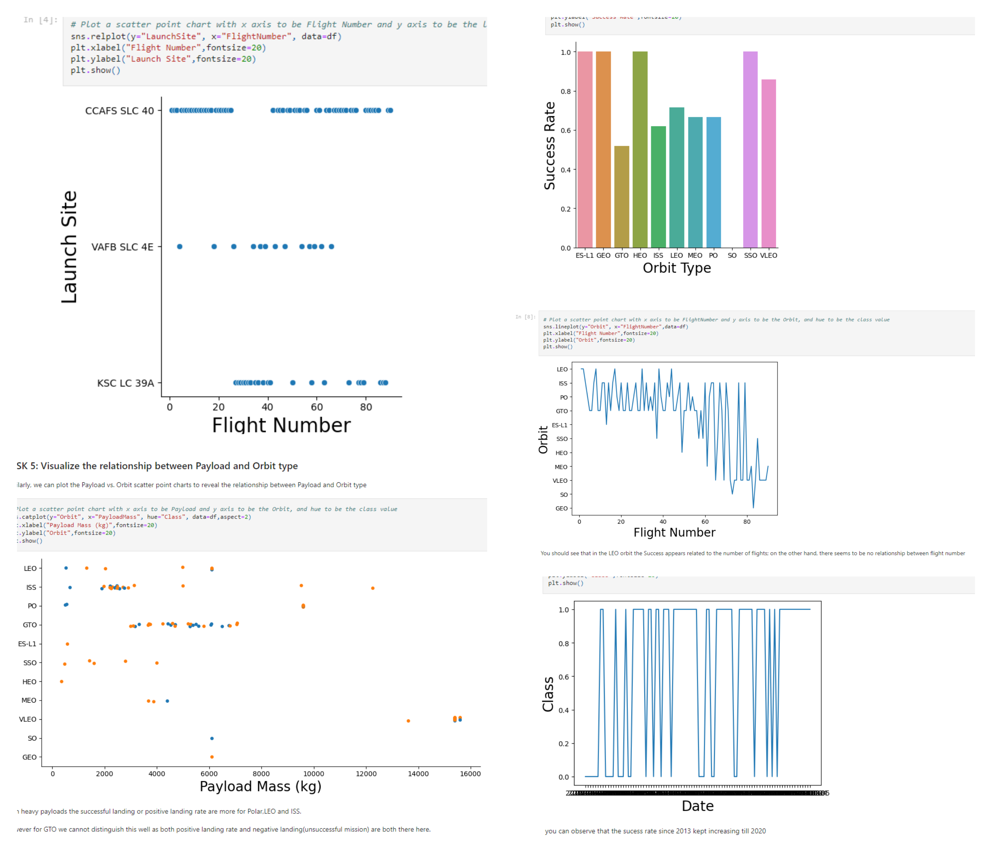
EDA with Data Visualization
Charts plotted :
Github Link : https://github.com/JohnsonManuel/Capstone-IBM/blob/master/EDA%20WITH%20Visialization-%20IBM%20-%20WEEK%202.ipynb

Slide 12
EDA with SQL
Using bullet point format, summarize the SQL queries you performed
The Sql Queries were done on the various falcon 9 Launches and its success and failures from different periods of time were calculated and were displayed as tables.
The Data gave a clear overview of what to expect in terms of wrangling and data analysis standpoints.
GitHub Notebook URL: https://github.com/JohnsonManuel/Capstone-IBM/blob/master/EDA%20with%20SQL%20-%20IBM%20-%20Week%202.ipynb

Slide 13
Build an Interactive Map with Folium
The folium the map was drawn with NASA Johnson Space Center at Houston, Texas as its center . Some of the launch sites in the data are marked down.The success and failures of each launch sites are also marked.
The distance between the launch sites are also marked down. To extract more information on the data set.
Github Notebook URL: https://github.com/JohnsonManuel/Capstone-IBM/blob/master/Interactive%20Visual%20Analytics%20with%20Folium%20Lab%20-%20Week%203.ipynb

Slide 14
Predictive Analysis (Classification)
The data was loaded and the train/test split was done . The model was created on the training set and the GridSearchCV object was used.
A Confusion matrix was formed and the best parameters for a grid search was also created and the model was trained again.
Finally the model gave a prediction accuracy of 83- 84 percent.
GitHub Notebook URL: https://github.com/JohnsonManuel/Capstone-IBM/blob/master/Machine%20Learning%20Prediction%20lab.ipynb

Slide 15
Results
The data was analyzed in various ways and the values are understood .
The Data was plotted in various graphs and then used to represent the values in various ways.
Finally the data was trained and then the model gave a prediction accuracy of 84%

Slide 16

Section 2

Slide 17
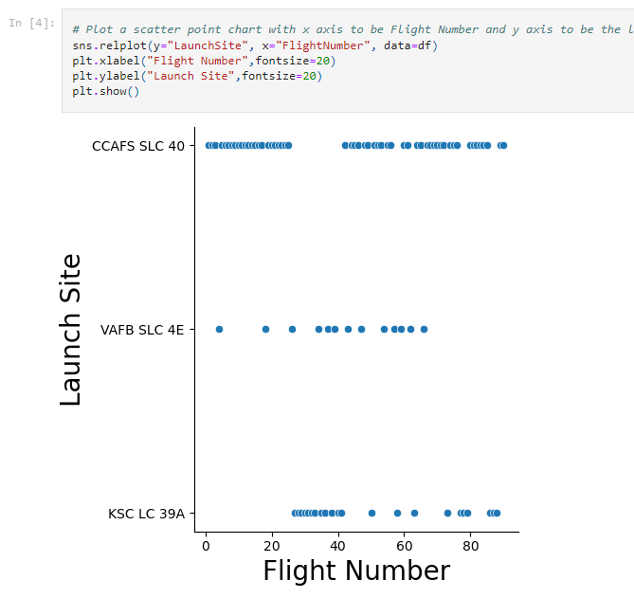
Flight Number vs. Launch Site
Show a scatter plot of Flight Number vs. Launch Site
Show the screenshot of the scatter plot with explanations

Slide 18
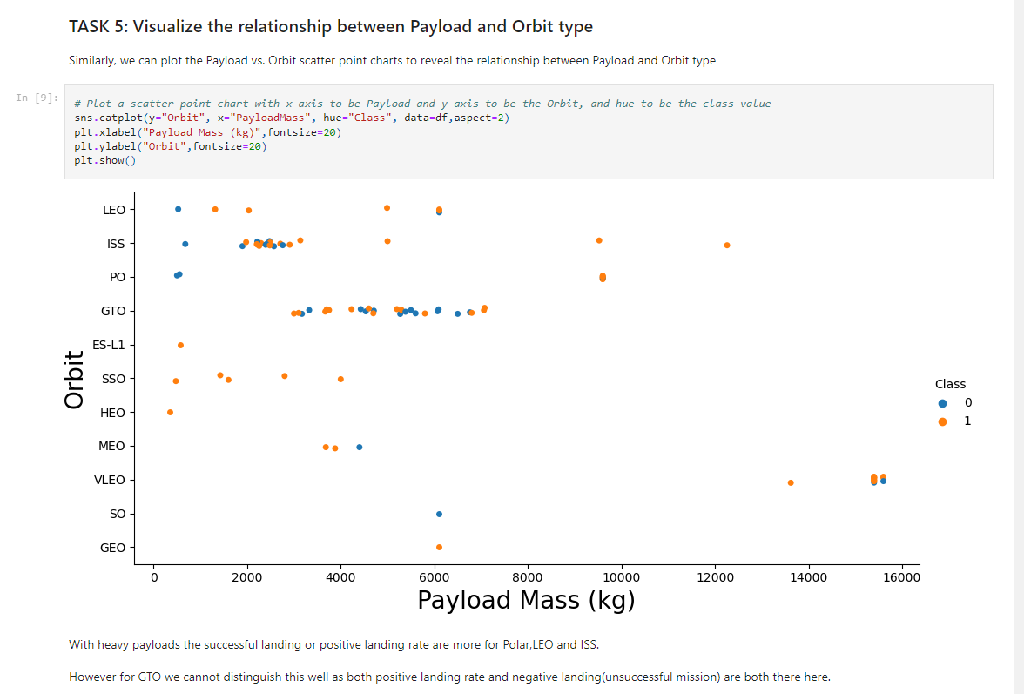
Payload vs. Launch Site
Show a scatter plot of Payload vs. Launch Site
Show the screenshot of the scatter plot with explanations

Slide 19
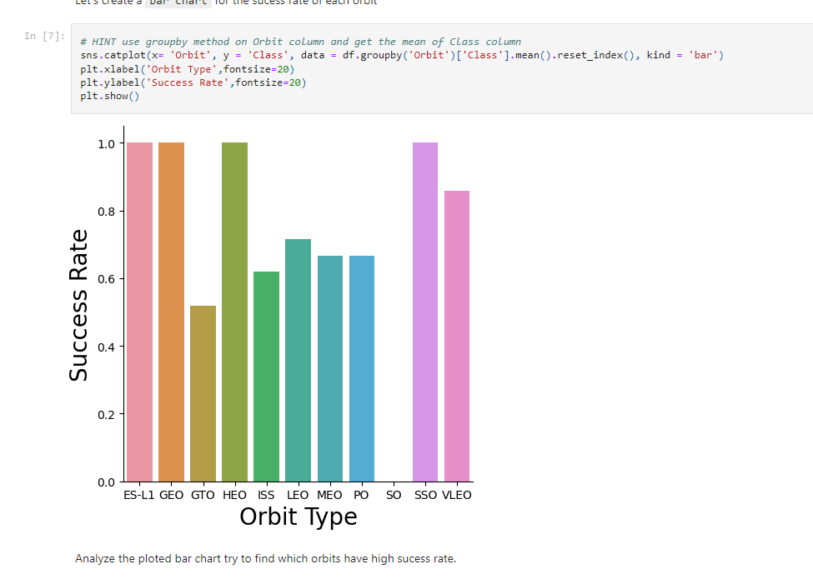
Success Rate vs. Orbit Type
Show a bar chart for the success rate of each orbit type
Show the screenshot of the scatter plot with explanations

Slide 20
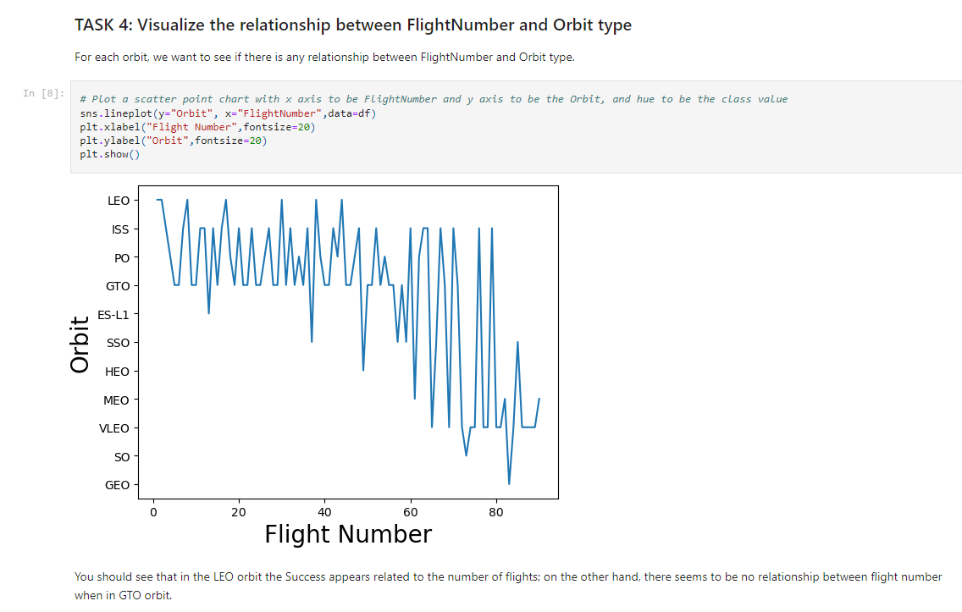
Flight Number vs. Orbit Type
Show a scatter point of Flight number vs. Orbit type
Show the screenshot of the scatter plot with explanations

Slide 21
Payload vs. Orbit Type
Show a scatter point of payload vs. orbit type
Show the screenshot of the scatter plot with explanations

Slide 22
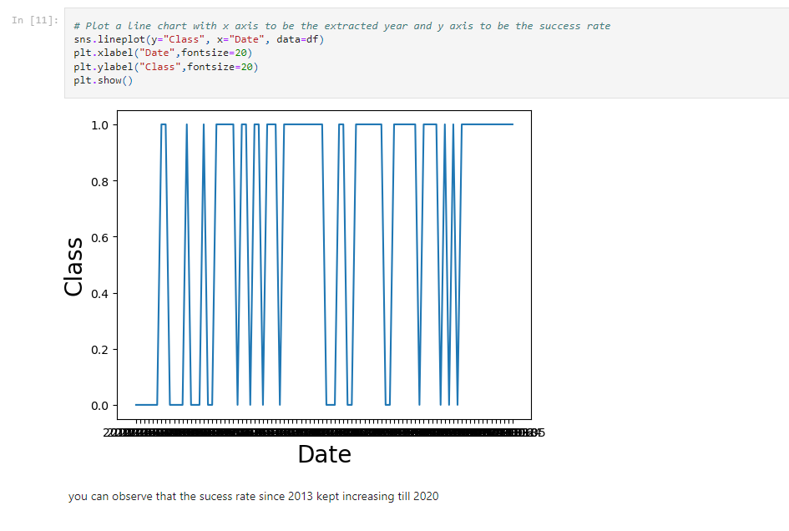
Launch Success Yearly Trend
Show a line chart of yearly average success rate
Show the screenshot of the scatter plot with explanations

Slide 23
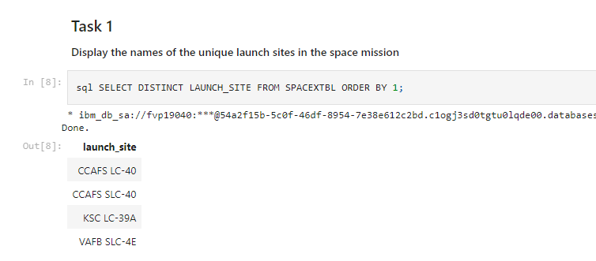
All Launch Site Names
Find the names of the unique launch sites
Launch sites are clearly mentioned above

Slide 24
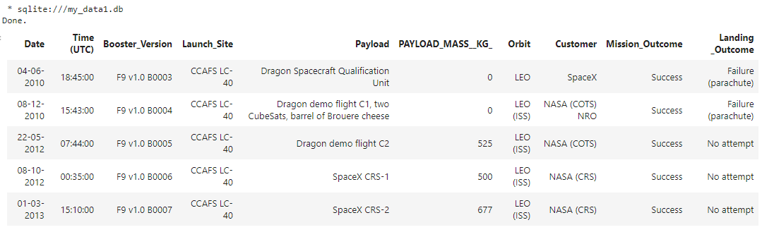
Launch Site Names Begin with 'CCA'
Find 5 records where launch sites begin with `CCA`

Slide 25
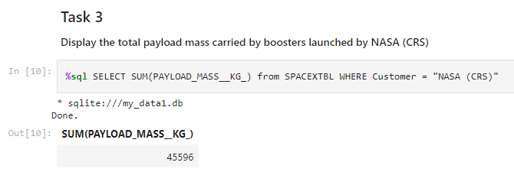
Total Payload Mass
Calculate the total payload carried by boosters from NASA

Slide 26
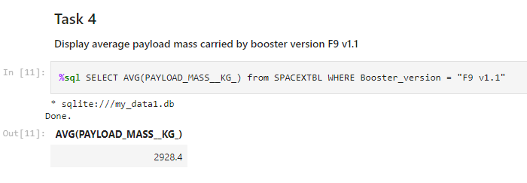
Average Payload Mass by F9 v1.1
Calculate the average payload mass carried by booster version F9 v1.1

Slide 27
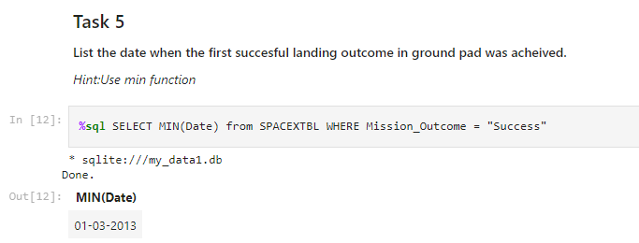
First Successful Ground Landing Date
Find the dates of the first successful landing outcome on ground pad

Slide 28
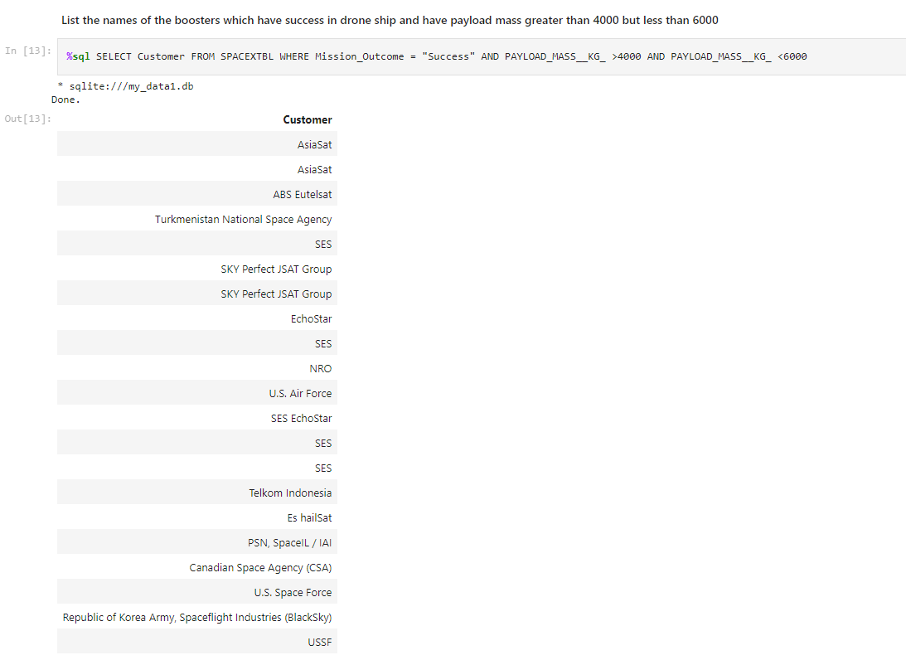
Successful Drone Ship Landing with Payload between 4000 and 6000
List the names of boosters which have successfully landed on drone ship and had payload mass greater than 4000 but less than 6000

Slide 29
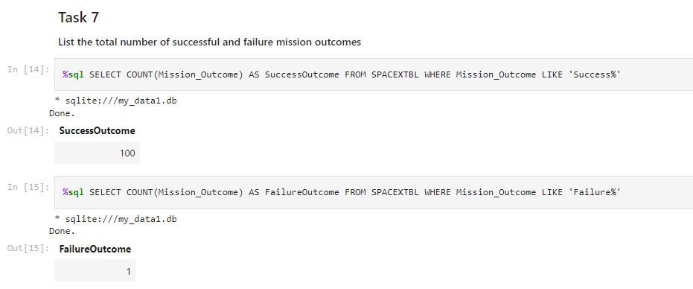
Total Number of Successful and Failure Mission Outcomes
Calculate the total number of successful and failure mission outcomes

Slide 30
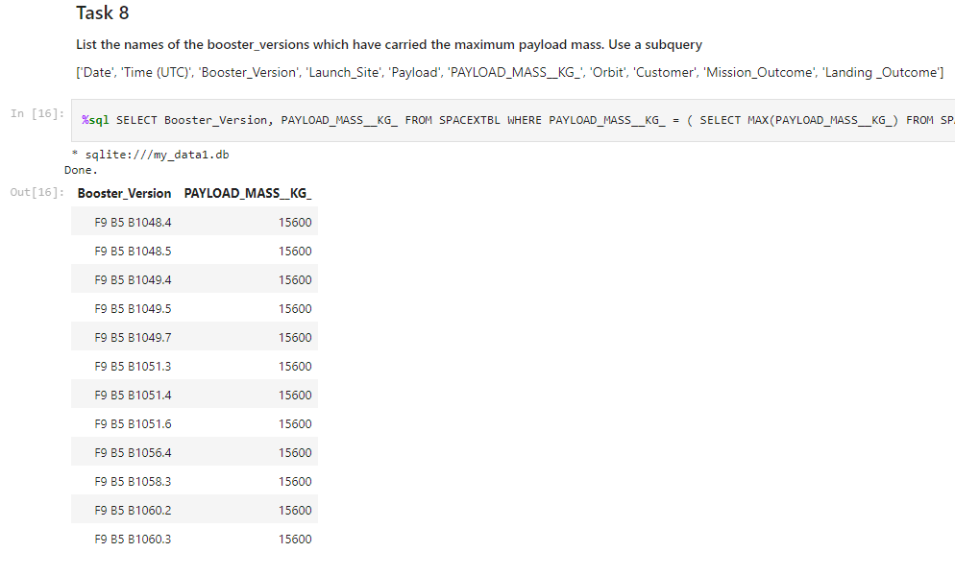
Boosters Carried Maximum Payload
List the names of the booster which have carried the maximum payload mass

Slide 31
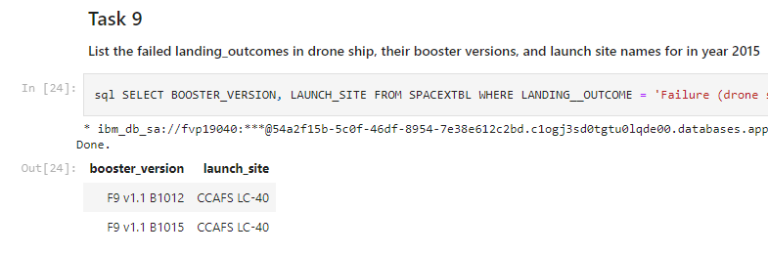
2015 Launch Records
List the failed landing_outcomes in drone ship, their booster versions, and launch site names for in year 2015

Slide 32
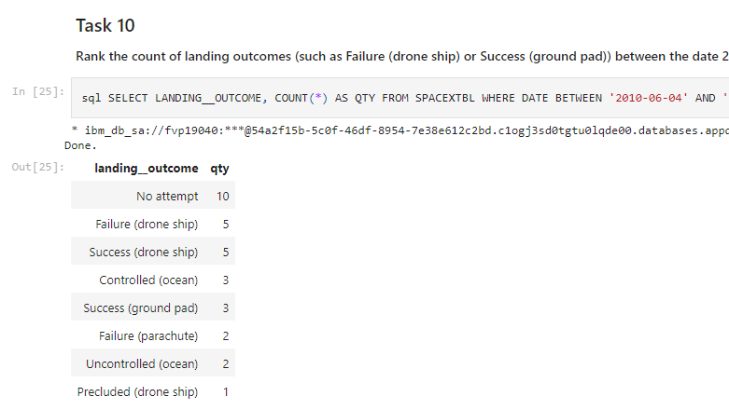
Rank Landing Outcomes Between 2010-06-04 and 2017-03-20
Rank the count of landing outcomes (such as Failure (drone ship) or Success (ground pad)) between the date 2010-06-04 and 2017-03-20, in descending order

Slide 33

Section 3

Slide 34
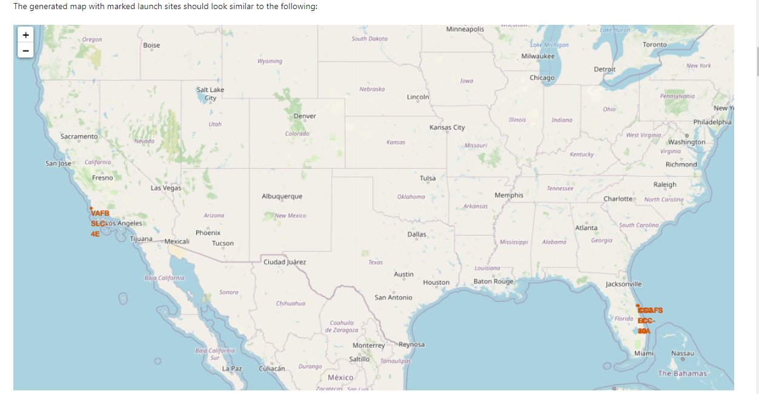
All launch sites on a map

Slide 35
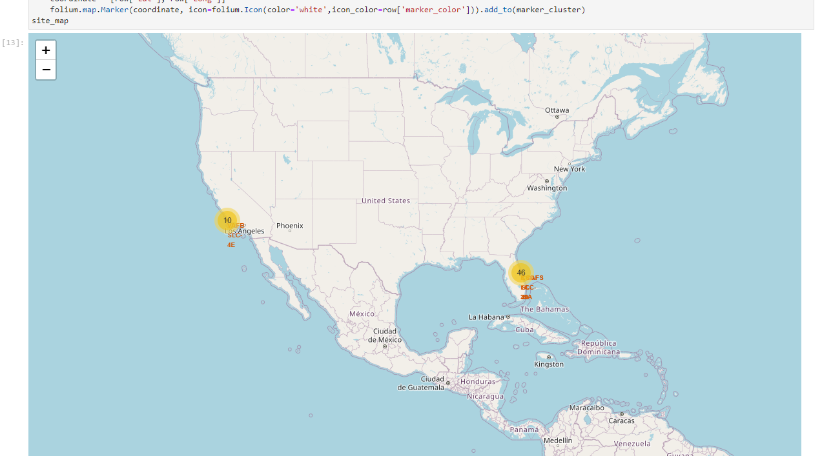
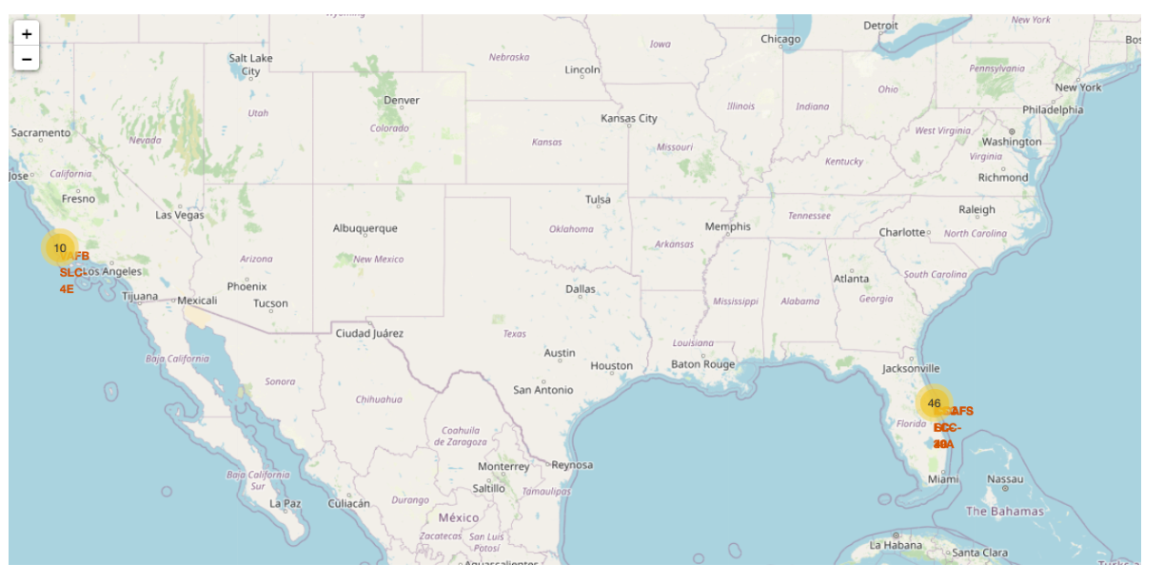
Locations of success and failures in landings

Slide 36
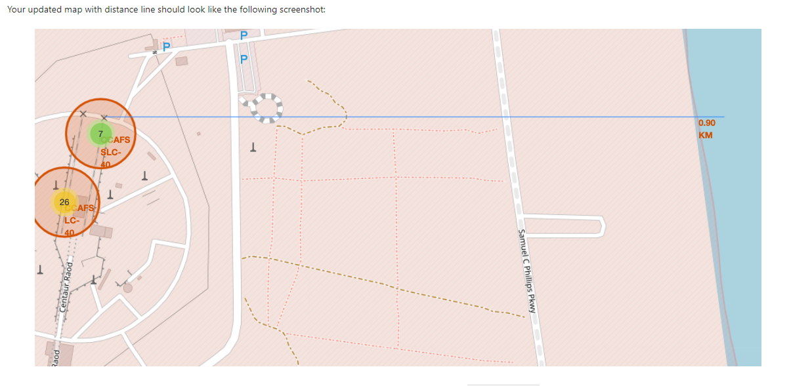
Distance between the sites

Slide 37

Section 5

Slide 38
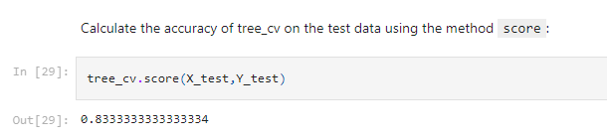
Classification Accuracy

Slide 39
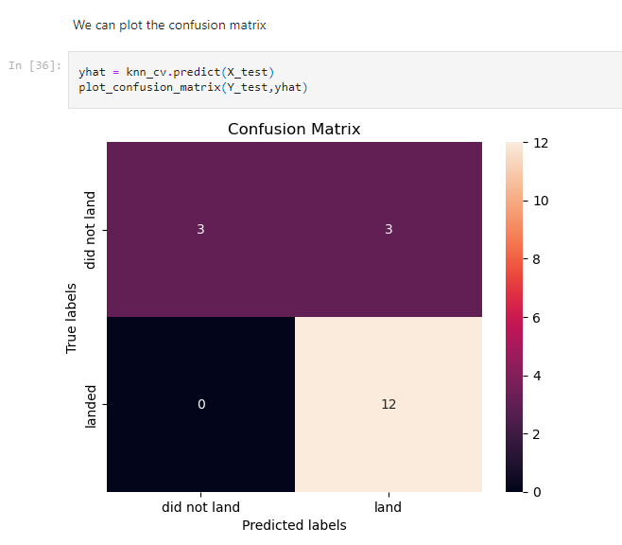
Confusion Matrix

Slide 40


